Slide 1
Overcoming Barriers to a Collaborative and Transdisciplinary One Health Approach
Comments by
Bernadette Dunham, D.V.M., Ph.D.
Professorial Lecturer
Milken Institute School of Public Health
The George Washington University
for the
One Health Social Sciences Initiative
One Health Commission
December 11, 2018

Slide 2

Executive Director: Cheryl Stroud, D.V.M., Ph.D.
One Health Commission Website: https://www.onehealthcommission.org/
(The One Health Commission is a globally focused organization dedicated to promoting improved health of people, domestic animals, wildlife, plants and the environment. It is a 501(c)(3) organization, chartered in Washington, D.C. on June 29, 2009.)

Slide 3
Co-ChaIrs:
Jennifer Ida, MA Ph.D.-Stud.
Laura Streichert, Ph.D., MPH
Lisa Webb, D.Psy. MPH, MBA
One Health Social Sciences Initiative
https://www.onehealthcommission.org/en/programs/one_health_social_sciences_initiative/

Slide 4
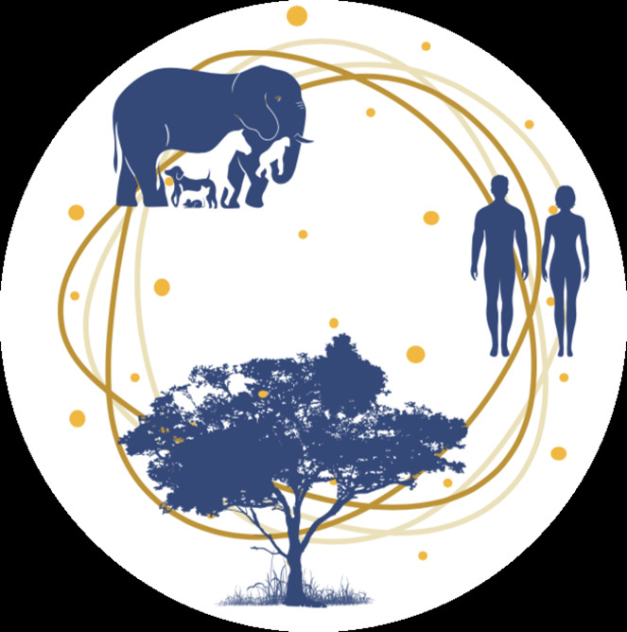
The Concept of One Health
The concept of One Health is not really new, considering the fact that 2,500 years ago it was Hippocrates who
“urged physicians to consider…
where their patients lived,
the foods they ate,
the waters they drank,
their lifestyles, and
the seasons of the year.”

Slide 5
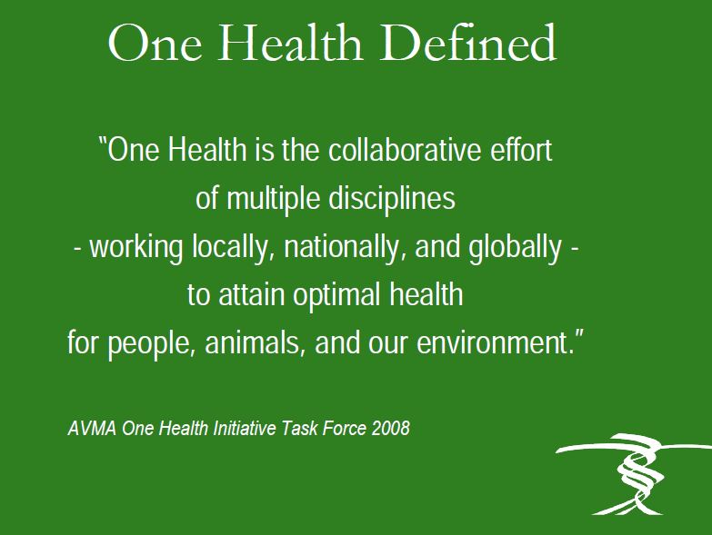

Slide 6
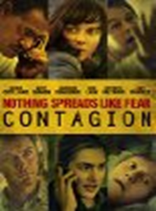
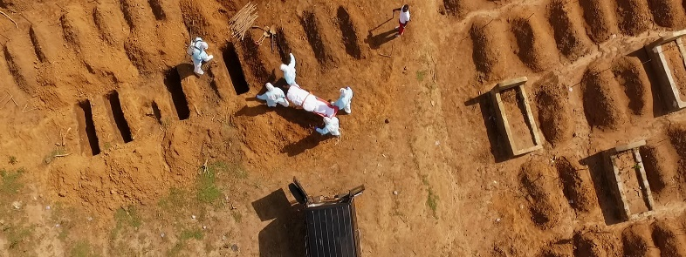
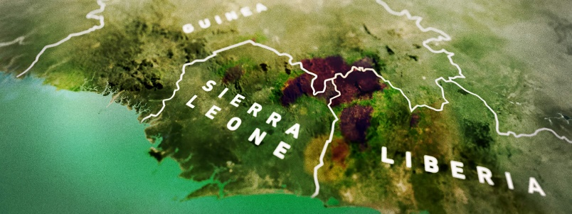
Setting the stage…
One Health video clip (3.0 min): https://www.youtube.com/watch?v=2pyLm2j3jxI&feature=youtu.be
CDC One Health video clip (2.5 min): https://www.youtube.com/watch?v=TG0pduAYESA
Additional information is available from the PBS documentary entitled Spillover (55.56 min): http://www.pbs.org/spillover-zika-ebola-beyond/home/

Slide 7
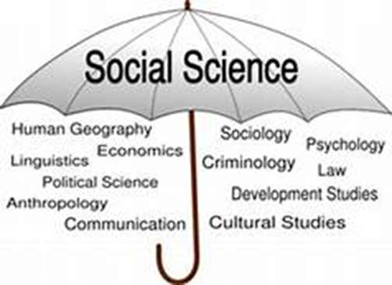

What is Social Science?
A category of academic disciplines, concerned with society and the relationships among individuals within a society.
Social science as a whole has many branches, each of which is considered a social science.
The social sciences include, but are not limited to: anthropology, communication studies, economics, history, human geography, jurisprudence, linguistics, political science, psychology, public health, and sociology.

Slide 8
Global Health Competencies
Global burden of disease
Globalization of health and healthcare
Social and environmental determinants of health
Capacity strengthening
Teamwork/collaboration and communication
Ethical reasoning
Professional practice
Health equity and social justice
Program management
Social, cultural and political awareness
Strategic analysis
Communication
Source: The Journal of Law, Medicine & Ethics. Special Issue: Symposium-Special Supplement, Interprofessional Global Health Education: Ensuring the Collaborative Promise of 21st Century Global Health Practice. Vol 42, Issue s2, pg. 26-31. 2014.

Slide 9
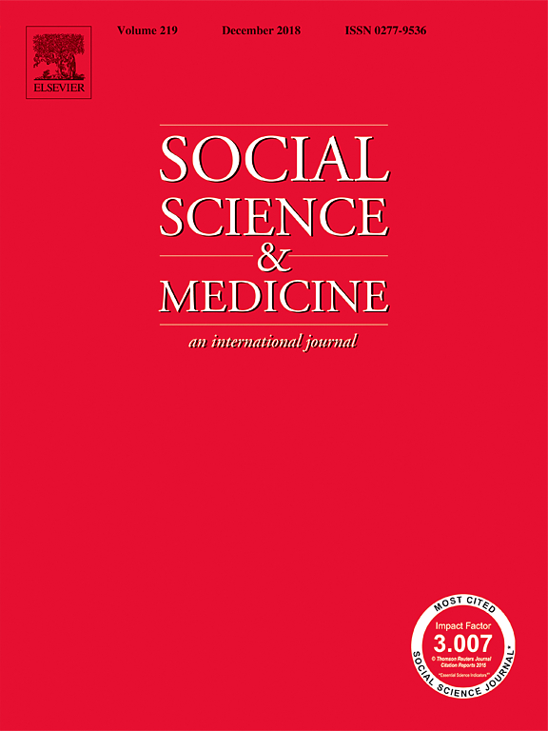
National Academies of Sciences, Engineering, Medicine June 2018
http://www.nationalacademies.org/hmd/Activities/Global/PublicPrivatePartnershipsForum/2018-JUN-13.aspx
Social Science & Medicine provides an international and interdisciplinary forum for the dissemination of social science research on health.
https://www.journals.elsevier.com/social-science-and-medicine

Slide 10
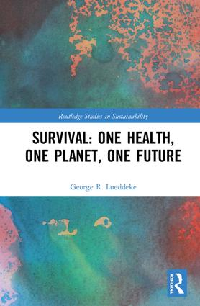
“One Health – recognizing the fundamental interconnections between people, animals, plants, the environment – needs to inform the UN-2030 Sustainable Development Goals and that working towards the adoption of a new mindset is essential. We need to replace our current view of limitless resources, exploitation, competition and conflict, with one that respects the sanctity of life and strives towards well-being for all, shared prosperity and social stability.”
George R. Luddeke https://www.routledge.com/Survival-One-Health-One-Planet-One-Future/Lueddeke/p/book/9781138334953

Slide 11
Transforming our world: The 2030 Agenda for Sustainable Development
‘All countries and all stakeholders, acting in collaborative partnership, will implement this plan.’
Many of these United Nations goals demonstrate a One Health approach.
http://www.un.org/ga/search/view_doc.asp?symbol=A/RES/70/1&Lang=E

Slide 12
Challenges/Barriers We Face in Advancing One Health
Language barriers
Prejudices
Building respect and trust
Communication skills
Understanding cultures
Listening – seek first to understand
Advocacy skills
Willingness to change
Economics

Slide 13
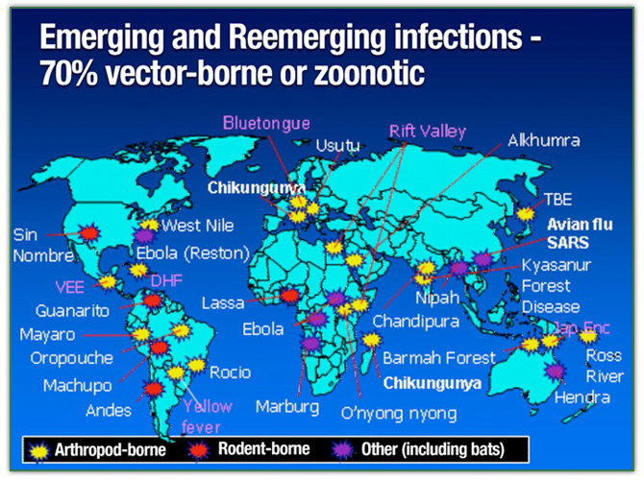
Emerging & Re-emerging infections
75%
Zika
Created by Thomas P. Monath, MD for the One Health Initiative website. http://www.onehealthinitiative.com/index.php

Slide 14
Zika Virus – Exemplifies “One Health”
The One Health approach brings together entomologists, physicians, veterinarians, virologists, wild life biologists, environmental experts, universities, governments, public health organizations, world health organizations, just to mention a few… all seeking to help address the following needs:
Zika virus infection is usually asymptomatic or causes mild illness (e.g. fever, rash, muscle/joint pain), however, CDC has concluded that Zika virus infection during pregnancy can cause microcephaly and other severe fetal brain defects.
Commercial vaccines and specific antiviral drug treatment for Zika virus infection are needed. Funding for basic research and vaccine/drug development is required.
Diagnostic tests for Zika virus (e.g. blood, urine or saliva samples) need to be developed and then approved by the FDA.

Slide 15

Zika Virus – Exemplifies “One Health” cont’d
Mosquito (Aedes genus) vector control needs focused intervention (e.g. removal of water-containing sources; insecticide sprays; utilizing genetically engineered mosquitoes to suppress the mosquito population); risk communication/education to help the public avoid mosquito exposure.
Enhanced surveillance systems are needed; take advantage of apps via smartphones; collecting and analyzing data to assist with public health strategies.
Medical care of new born infants with microcephaly is needed which means assessing the medical infrastructure at local and national levels; financial commitment; government engagement; policy development at local, national, international levels.
http://www.who.int/mediacentre/factsheets/zika/en/

Slide 16
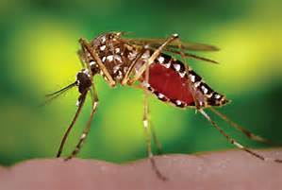
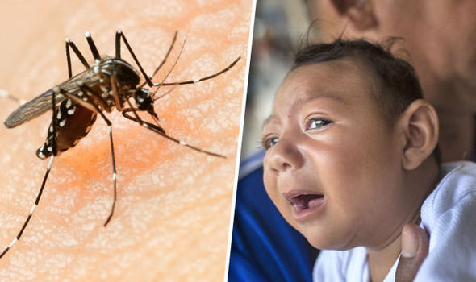
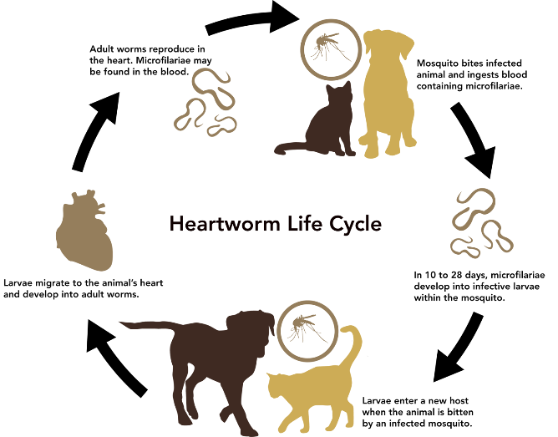
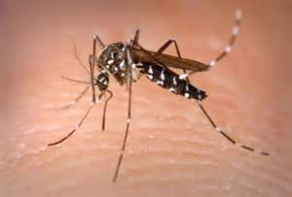
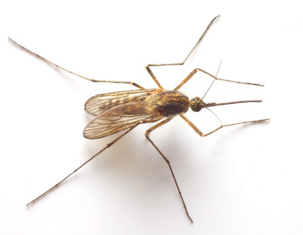
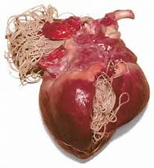
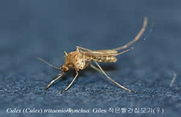
A few examples of Mosquito borne diseases
Aedes aegypti mosquito transmits Dengue,
Chikungunya, Yellow fever, and Zika viruses.
Mosquito transmitted Zika virus
can cause microcephaly.
Asian Tiger (Aedes albopictus)
transmits West Nile virus,
Equine Encephalitis virus.
Anopheles sp. transmits malaria
(Plasmodium falciparum).
Culex tritaeniorhynchus
transmits Japanese
encephalitis virus.
Mosquito transmitted Dirofilaria immitis heartworm larvae. (Aedes aegypti, Aedes albopictus, Aedes canadensis, Aedes sierrensis, Aedes trivitattus, Aedes vexans, Anopheles punctipennis, Anopheles quadrimaculatus, and Culex quinquefasciatus.)

Slide 17
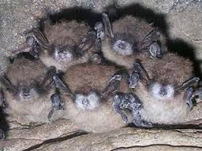
White-nose Syndrome in Bats – loss of pollinators
White-nose Syndrome (WNS) is a diseases caused by the fungus Pseudogymnoascus destructans. The disease is estimated to have killed over six million bats in eastern North America since 2006, and can kill up to 100% of bats in a colony during hibernation. The disease is caused by a fungus from Eurasia, which was accidentally transported here by humans.
Bats are important for:
Pest control - the primary predators of night-flying insects including many damaging agricultural pests.
Pollination – from deserts to rainforests, nectar-feeding bats are critical pollinators for a wide variety of plants of great economic and ecological value.
Seed dispersion – fruit eating bats scatter seeds helping to restore forests.
We can expect to see significant ecosystem changes in the coming years following the loss of the bat population!
https://www.nwhc.usgs.gov/disease_information/white-nose_syndrome/
https://vimeo.com/76705033
Research projects are focused
on managing WNS - identifying
a biological control agent for
the fungus is key. UV irradiation
may prove helpful.
Active collaboration with scientists, managers, lawmakers and the public is needed to
address WNS via a One Health approach!
https://www.whitenosesyndrome.org/sites/default/files/resource/blehert_et_al_2008_wns_fungus_total.pdf

Slide 18
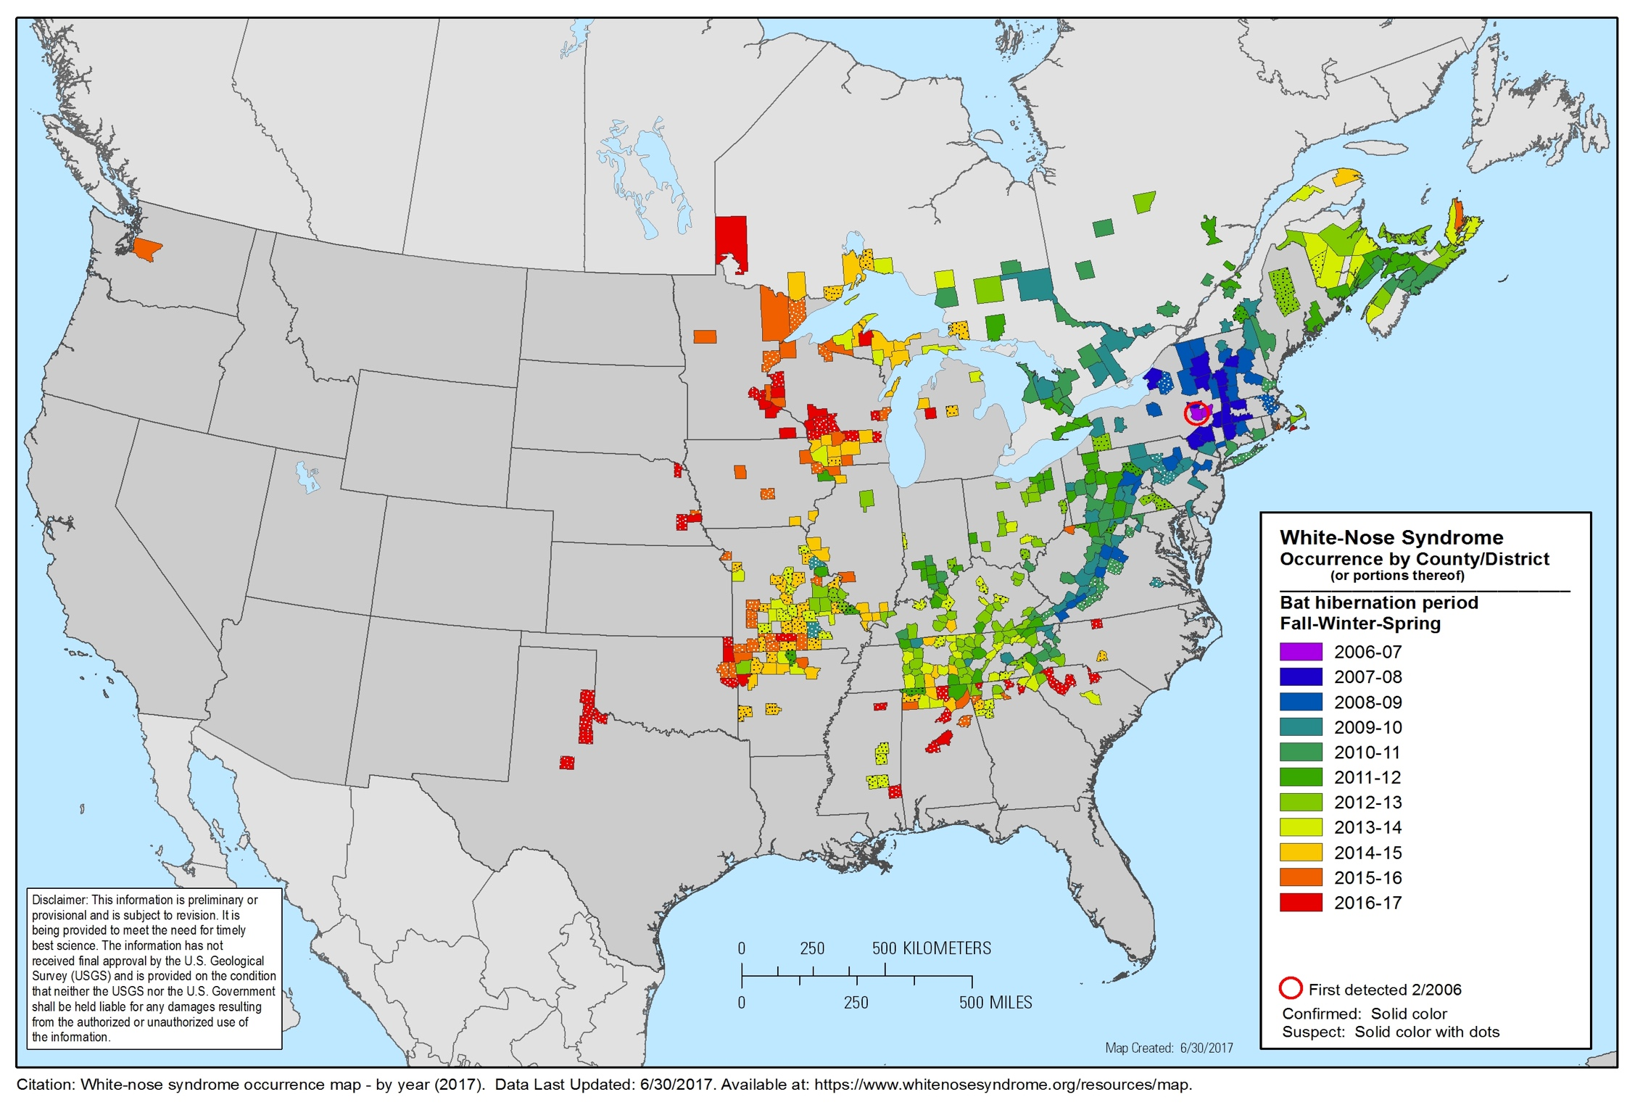

Slide 19
Fruit Bats – Date Palm Sap - Nipah Virus
Pteropus fruit bats are commonly infected with Nipah virus, but show no signs of illness.
Human Nipah outbreaks in Bangladesh coincided with the date palm sap harvesting season.
In epidemiologic studies, drinking raw date palm sap is a risk factor for human Nipah infection, if bats have contaminated the sap.
Infrared cameras revealed the bats access to the collecting containers – often urinating into them.
Lessons learned led to villagers making covers to avoid bat contamination of the collected date palm sap - a sugary syrup that humans and bats both like!

Slide 20
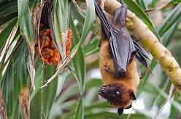
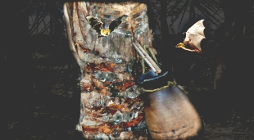
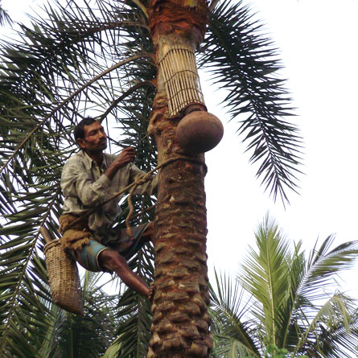
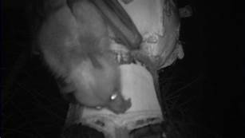
Fruit Bats - Date Palm Sap - Nipah virus
Pteropsus fruit bat
Unprotected sap container
Infrared cameras reveal bat accessing sap container
Protected sap container

Slide 21
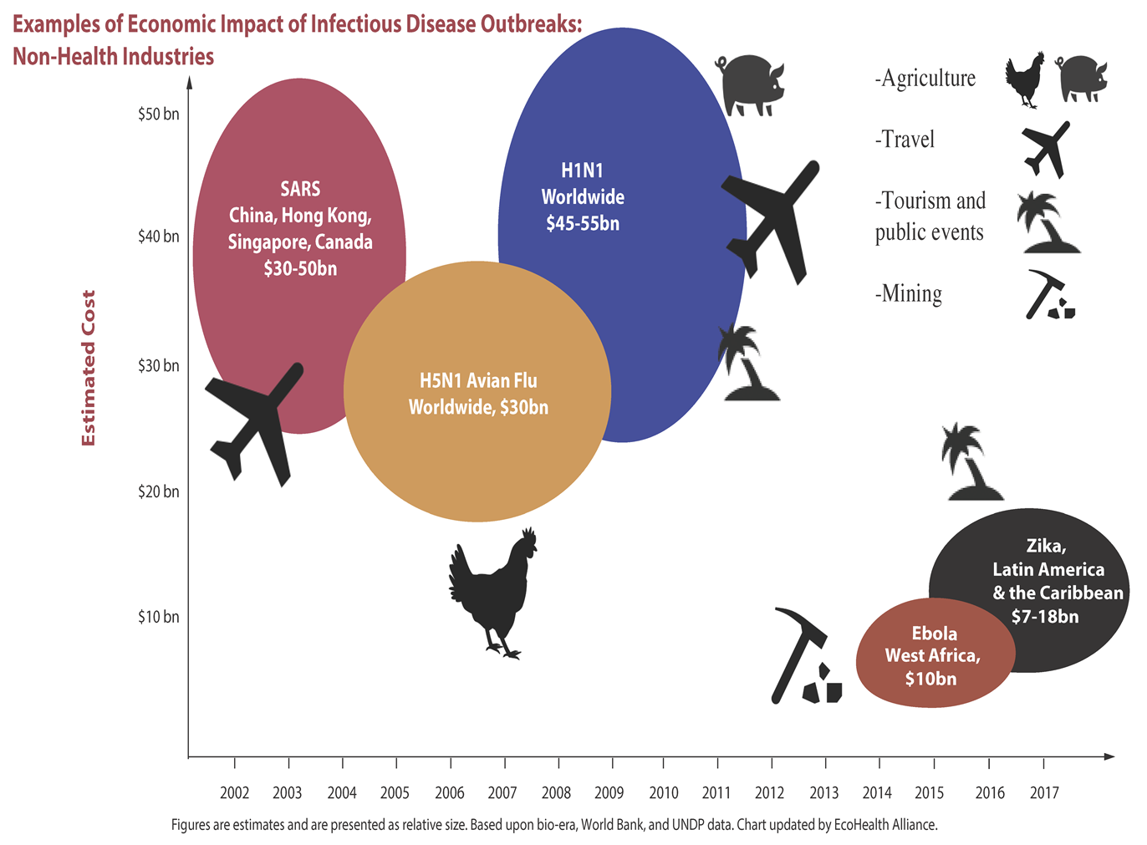
[Slide credit: World Banking on One Health, October 11, 2017 presentation by Dr. Tim Bouley at the Uppsala Health Conference, Uppsala, Sweden.]

Slide 22
On 4/27/2018 the World Bank released their
“One Health Operational Framework for strengthening human, animal and environmental public health systems at their interface”
The Operational Framework is intended as a guide for One Health operations, from project and program scoping and identification stages to design and implementation, including monitoring and evaluation, to help optimize investments. http://documents.worldbank.org/curated/en/703711517234402168/Operational-framework-for-strengthening-human-animal-and-environmental-public-health-systems-at-their-interface

Slide 23
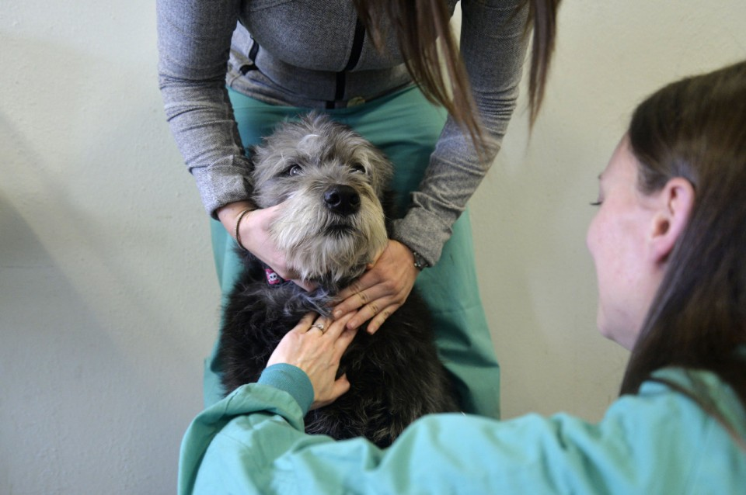
Animals as Sentinels
Free lead testing event for dogs in Flint water crisis
http://www.mlive.com/news/flint/index.ssf/2016/04/free_lead_testing_event_for_do.html
The test will not only check for lead but for other metals including copper, iron, mercury and zinc. More than 170 dogs have been tested during the previous three events.
Issues that can arise in dogs exposed to lead include the gastrointestinal system, with decreased appetite, vomiting and diarrhea. Brain involvement leads to dogs becoming easily agitated or showing signs of seizures.
Maggie, a terrier mix, is held by Michigan State University veterinary student Courtney Andries, of East Lansing, while veterinary technician Monica Reinke, of East Lansing, finishes drawing her blood during a free lead testing event for animals on Saturday, March 19, 2016 at the parish hall of St. Paul's Episcopal Church in Flint. The event was held by the Michigan State College of Veterinary Medicine amid Flint's water crisis. Rachel Woolf | MLive.com
“What the Eyes Don’t See - A Story of Crisis, Resistance & Hope in An American City” by Mona Hanna-Attisha, MD, MPH, FAAP (Published: 2018 One World – N.Y.)

Slide 24
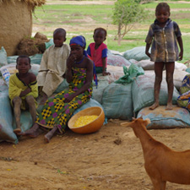
Lead poisoning in Northern Nigeria 2010
Early 2010 ducks began to disappear in Zamfara, Nigeria – no one thought it was important at the time.
By May 2010 hundreds of children became sick (vomiting, headaches & seizures)… and many died. Cause unknown.
Public health team sent in to investigate (CDC/Nigeria/WHO/ Doctors Without Borders/and an Animal-Human Interface Officer).
Villagers reported ¼ of all children in their communities had died.
Found unsafe levels of LEAD inside homes, in the water and in the soil… children had dangerous levels of lead in their blood.
Missed the clue that the deaths of the ducks could have alerted health officials of the crisis earlier… ducks were sentinels of an environmental hazard.
Recent mining for gold… no protective equipment; often brought rocks inside the homes to extract the gold; children were exposed to lead dust from the rocks.
Bottom Line: Largest known outbreak of Lead Poisoning in history!
355 cases: 163 deaths with 111 deaths of children.
Children sit on bags of lead-
contaminated soil, which were
removed from their village of
Zamfara during cleanup.
http://www.cdc.gov/onehealth/in-action/lead-poisoning.html

Slide 25
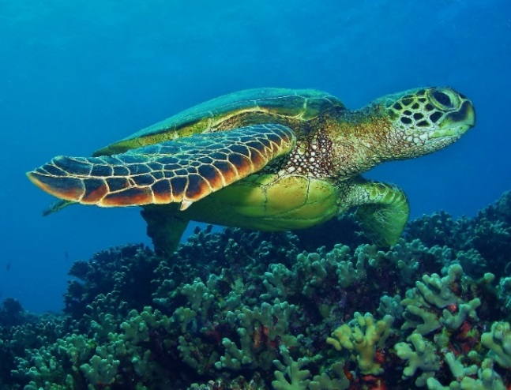
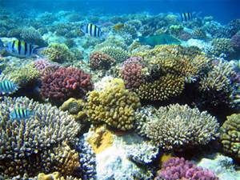
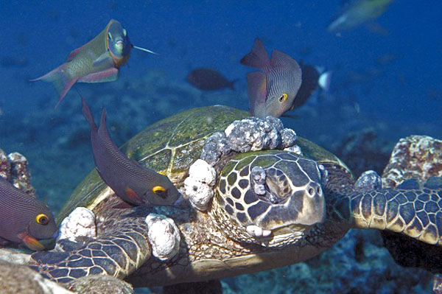
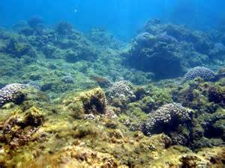
Marine Environmental Sentinels…
Healthy Green Sea Turtle
Healthy coral reef
Fibropapillomatosis in a Green Sea Turtle (can obstruct swimming, feeding, buoyancy, sight, and can lead to death). There is a strong link between this disease and the environmental health of the coastal habitat. [http://www.cabi.org/isc/datasheet/82638]
Unhealthy reef associated with
oceanic acidification
[http://coralreef.noaa.gov/education/oa/resources/22-4_kleypas.pdf]

Slide 26

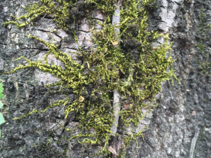
Plants as Biomonitors for Human and Animal Health
Air quality is monitored for public health safety… Portland , OR discovered an unexpected source: urban moss.
Moss lack true roots and absorb nutrients directly from the surrounding air.
Where air quality is poor the moss will appear dull and stunted.
2016 the OR Dept. of Environmental Quality & U.S. Forest Service teamed up to identify the source of cadmium and arsenic contamination in the city… two glass manufacturing facilities.
Once informed the manufacturers stopped using heavy metals and installed emission control devices.
https://www.outsideonline.com/2076011/how-portlands-unusual-moss-uncovered-air-pollution-problem

Slide 27
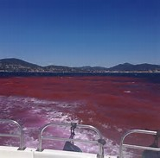
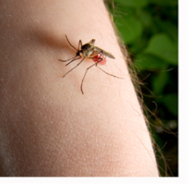
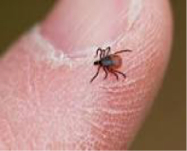
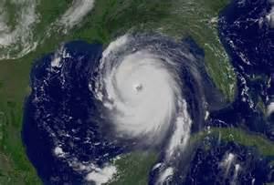
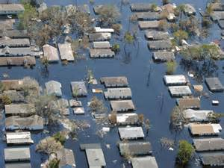
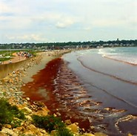
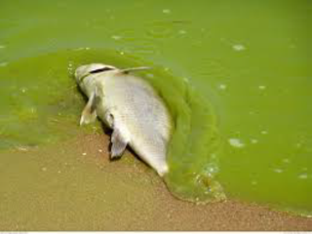
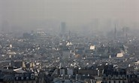
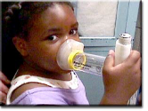
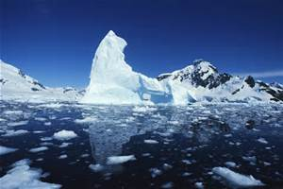
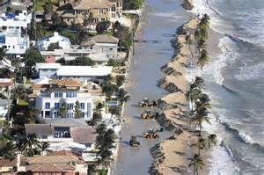
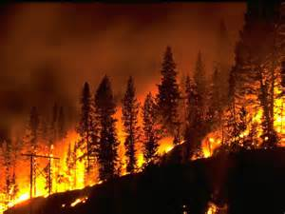
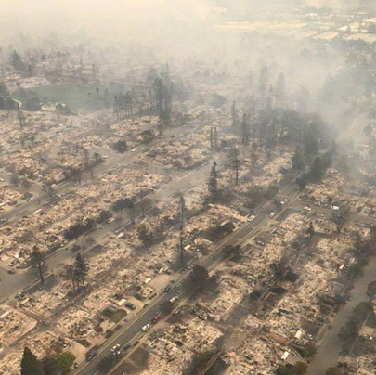
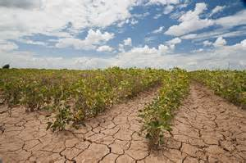
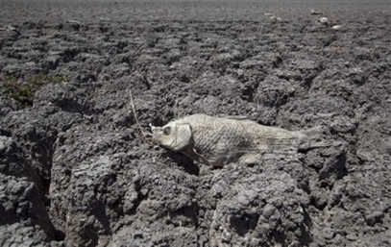
Climate Change…
Paris Climate Conference 12-12-2015 - A global climate deal to limit global warming to < 2^{O}C.
Montreal Protocol 10-15-2016 – A global agreement to reduce use of hydrofluorocarbons (HFCs), powerful greenhouse gases.
Vector
borne
diseases
Red Tide Algae
Blooms
More severe Tornados and Hurricanes
Floods
Air Pollution
Melting Glaciers and Ice fields
Rising sea levels
Wild Fires
Droughts

Slide 28
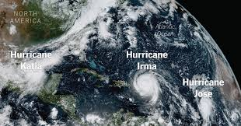
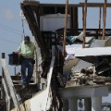
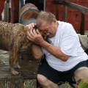

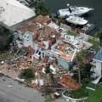
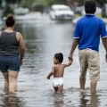




Courtesy of the NY Times
Atlantic Tropical Storms & Hurricanes in 2017
Tropical Storm Arlene, April 21 – rare to see in April
Tropical Storm Bret, June 19
Tropical Storm Cindy, June 20
Tropical Storm Don, July 17
Tropical Storm Emily, July 31
Hurricane Franklin, Aug. 6 Cat. 1 Veracruz, Mexico
Hurricane Gert, Aug. 13
Hurricane Harvey, Aug. 17 Cat. 4 Texas Aug. 25
Hurricane Irma, Aug. 30 Cat. 5 Caribbean Islands Sept. 6 & Florida Keys Sept 10
Hurricane Jose Sept. 5 Cat. 4 stays along Atlantic coast
Hurricane Katia Sept. 6 Cat. 1 Veracruz, Mexico
Hurricane Maria, Sept. 16 Cat. 5 Puerto Rico Sept. 19
Hurricane Nate, Oct. 4 Cat 1 New Orleans
Cat 1 74-95 mph
Cat 2 96-110 mph
Cat 3 111-129 mph
Cat 4 130-156 mph
Cat 5 >157 mph

Slide 29

WHO Addresses Climate Change http://www.who.int/news-room/fact-sheets/detail/climate-change-and-health (Feb. 2018)
NOAA. "New federal climate assessment for U.S. released: Report highlights impacts, risks and adaptations to climate change." ScienceDaily. (November 25, 2018). www.sciencedaily.com/releases/2018/11/181125113728.htm

Slide 30


NASA’s Global Precipitation Measurements (GPM) Disease Initiative and the Wilson Center - Vector and Waterborne Disease Workshop 5-17-2018 https://www.youtube.com/playlist?list=PLzM1iiQhVrdFx2rUclP16w93jGEhQ2oui

